Slide 1
MEDIA/PRESS
CONTINGENCY
PARTNER. SHIP. REDEFINED.
RAISING CREW AWARENESS
2020 Update

Slide 2
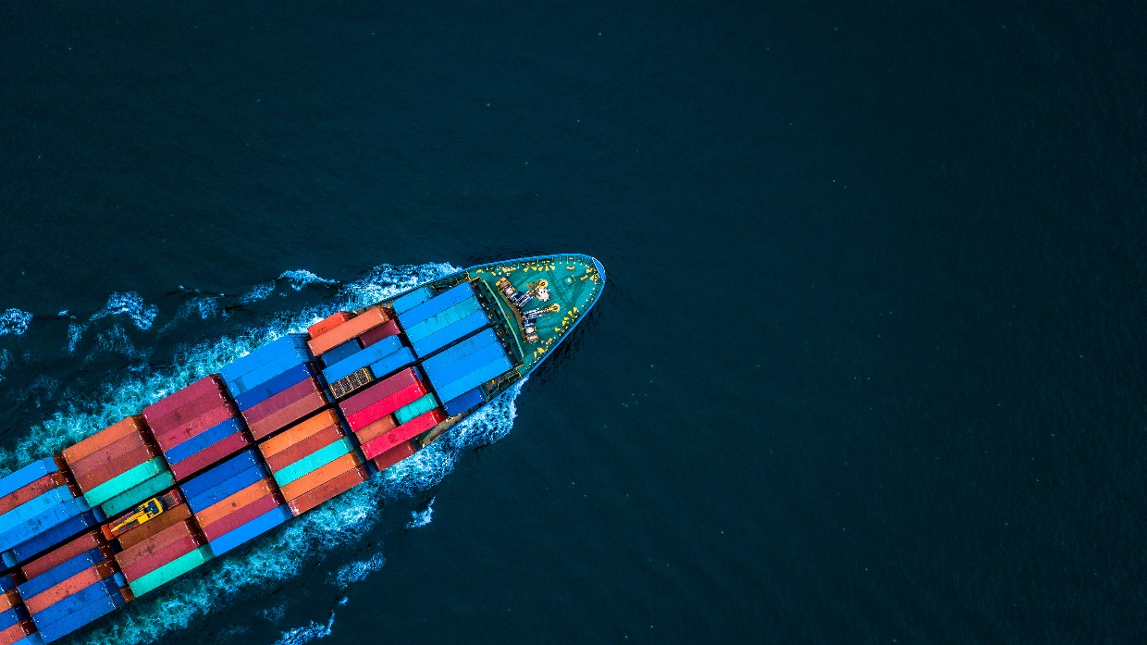
AWARENESS &
INTRODUCTION TO HANDLING MEDIA
Being an international company, Marlow Navigation can attract media attention
This can also include PR companies, bloggers, websites, social media

Slide 3

AWARENESS & GUIDANCE
KEY TO PROPER MANAGEMENT
Take control of the situation
But like all such fast-moving trends and technologies, the key to proper management is education and understanding, whilst practicing a careful approach.
Always use common sense and your best judgment

Slide 4


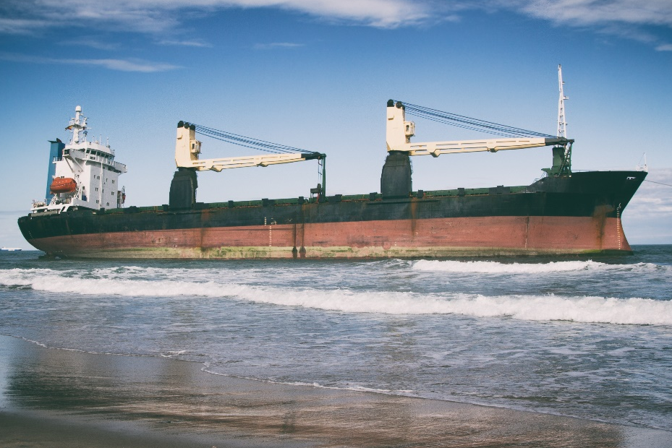

UNCERTAIN TIMES
EXTRA SENSITIVITY & CARE
This is especially important in case of any incident. Failure to comply can severely impede ongoing investigations, whilst also tarnish the Company’s and your own reputation, plus other serious consequences.
The same is true during highly uncertain times, such as with the COVID-19 pandemic, when the entire world is facing extraordinary challenges with strict government rules and controls, and the situation is changing on a regular basis.

Slide 5
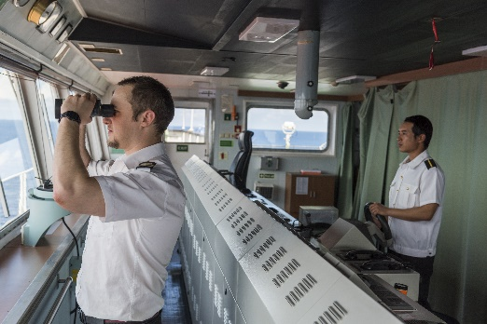
GIVING INFORMATION
WRONGLY DESTROYED IMAGE
Incident Happens
Crew Gives Info
Media Frenzy
USS John S McCain collided with commercial vessel Alnic MC
Crew member on bridge answered the call and gave information to Reuters media agency
Reuters then broke the news to the world media, who took the story and published information. This interfered with investigations.
Later it was proven that the USS John S McCain was at fault
But the brand damage to the commercial vessel was already done!

Slide 6
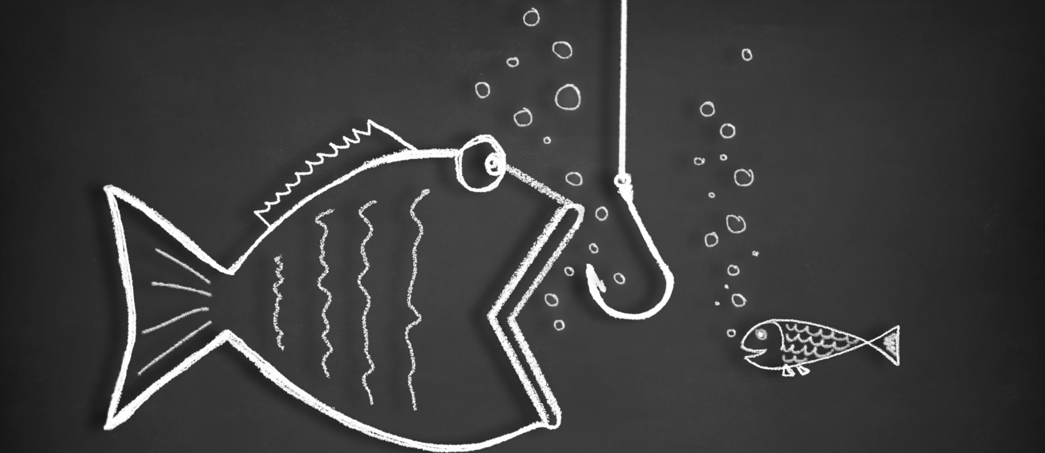
PRESS ALWAYS HUNGRY FOR SCOOP
DON’T BE THE BAIT!
I think I’ll just give them a nibble
Be careful, it’s not as great as they say out there!
Notes:
The media is always hungry for information and the next “scoop”. They’ll take anything
Don’t be bait!

Slide 7
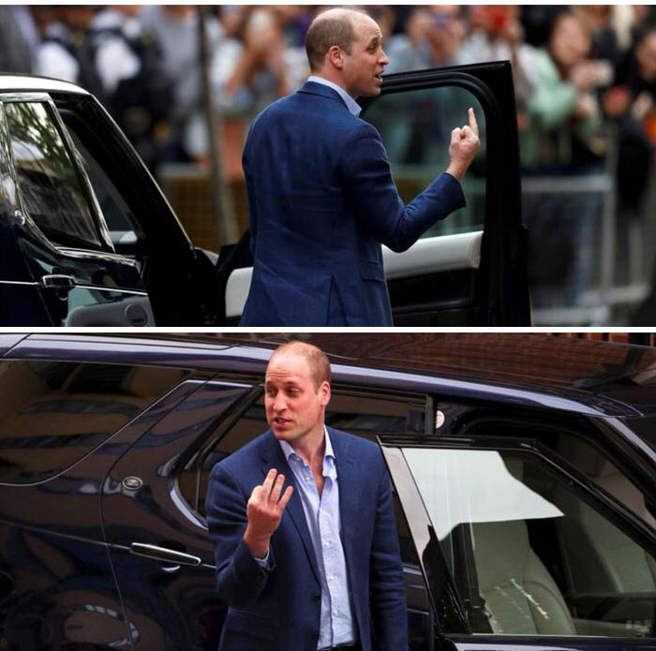
FEEDING THE PERCEPTION
ACCURACY DOESN’T ALWAYS RATE
The dangers of a one sided story

Slide 8
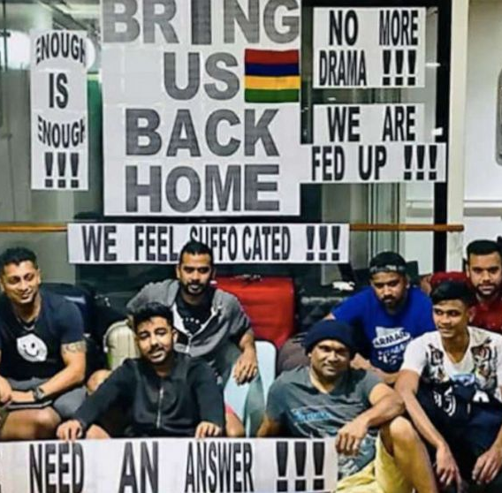
WRONG SIGNALS
INACCURATE & MISLEADING
In COVID-19 times
The dangers of a one sided story

Slide 9

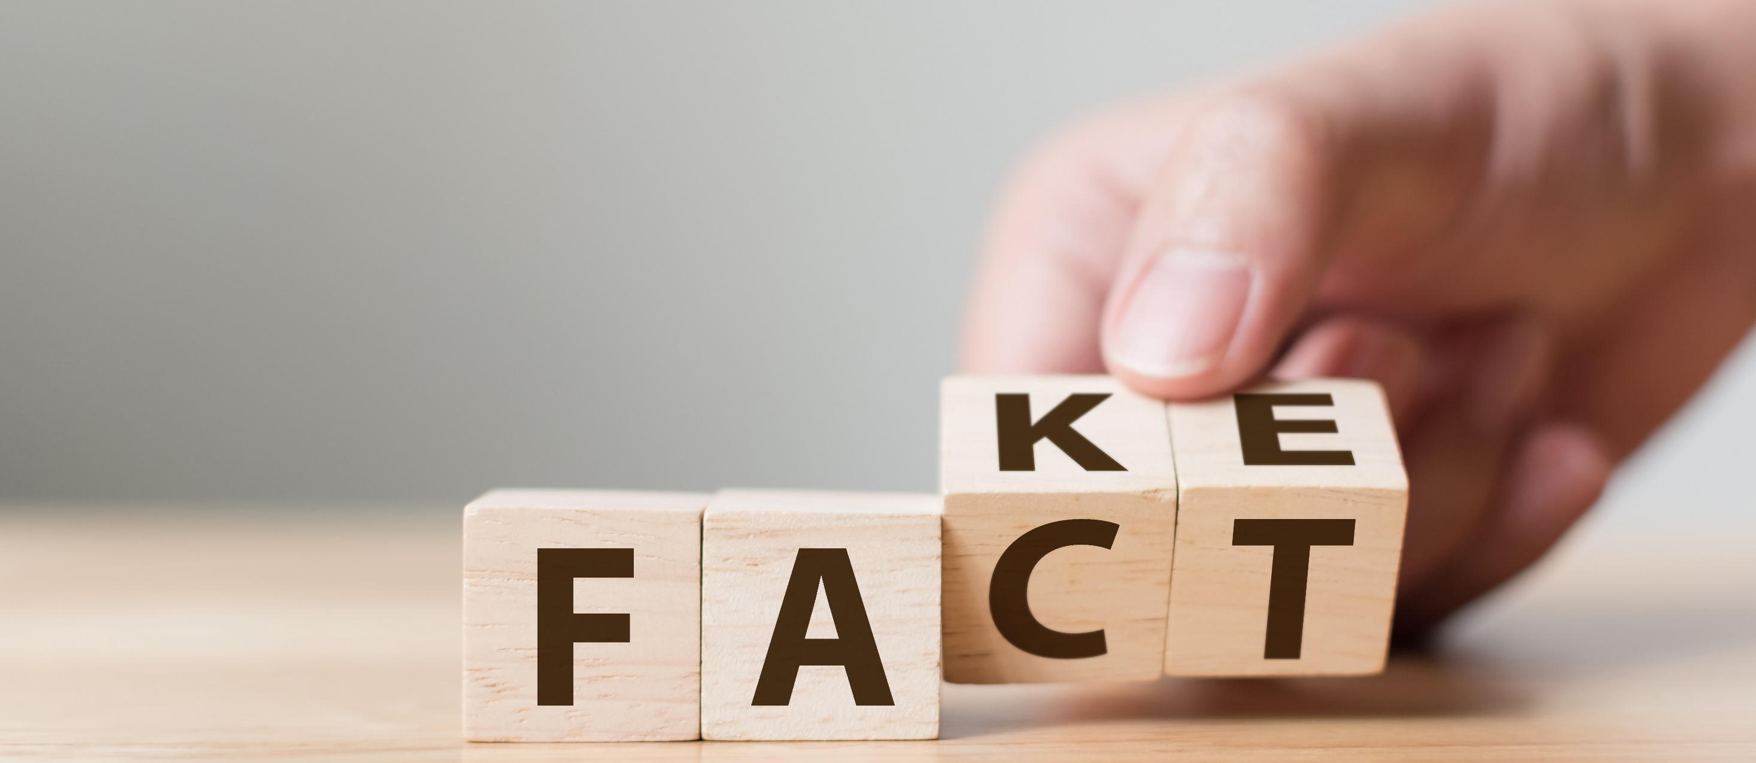
MANIPULATION
FAKE CAN EASILY BECOME FACT

Slide 10
SURPRISE CONTACT BY MEDIA
YOUR RESPONSIBILITIES
The Company will never send the Media without advance warning.
Contact your superior, as well as management immediately and let them know the situation.
You should always act with care, courtesy & professionalism.
Be aware that anything you say & do may be observed & reported; often misused. Always assume you are being recorded.
In some situations, the Media may be more persistent and immediate, such as during a crisis or major event. A reporter or camera crew may show up unannounced or attempt to make urgent contact.
Extra care and diligence is needed in such circumstances. Stay calm and collected.

Slide 11

DO NOT BE PUSHED TO RESPOND
KNOW YOUR RIGHTS
Do not let a reporter ambush you into answering questions on the spot or offering any information/material
It is perfectly fine & well within your rights to respond with courtesy & professionalism & say “Sorry, but I’m not the right person to talk to”, then refer them onwards to management or team nominated by Company
Notes:
Not just fine, but your responsibility to re-direct the media to the right contact, head office/management or spokesperson nominated by company

Slide 12

KNOW YOUR RIGHTS
DON’T LET THE MEDIA AMBUSH
The media cannot board a vessel seeking information without prior approval.
Take the journalist’s details – remember, they are obliged to identify themselves and their publication.
You should inform them that it is the Company’s Policy that all Media requests must be referred to the Management.
Sometimes, it might be difficult to prevent the filming or photographing from outside, but you should always do your utmost to clarify what’s going on and report.

Slide 13
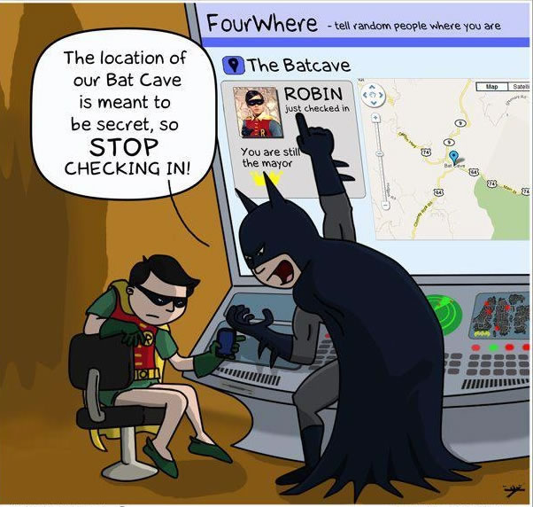
SEEMINGLY HARMLESS
EVERYDAY ACTIVITY…
Once posted, it’s broadcasted to the world!
What might seem to be good intentions or harmless action online…
Can jeopardise far and wide!

Slide 14
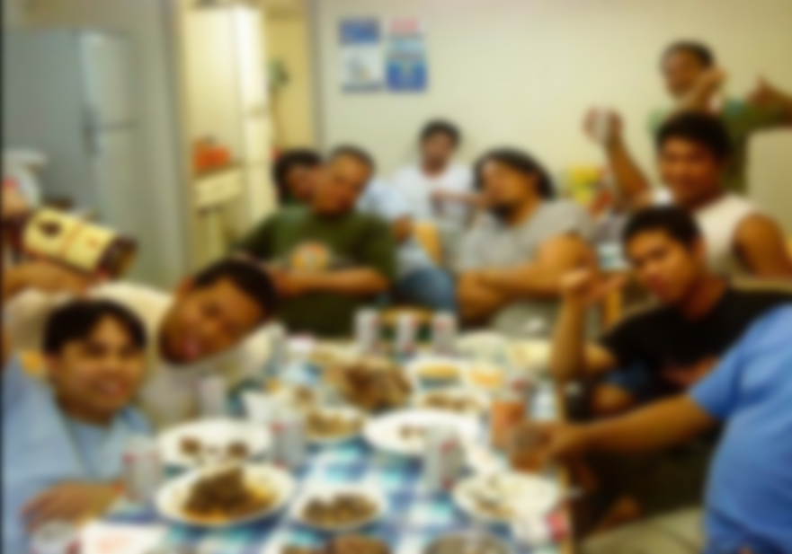
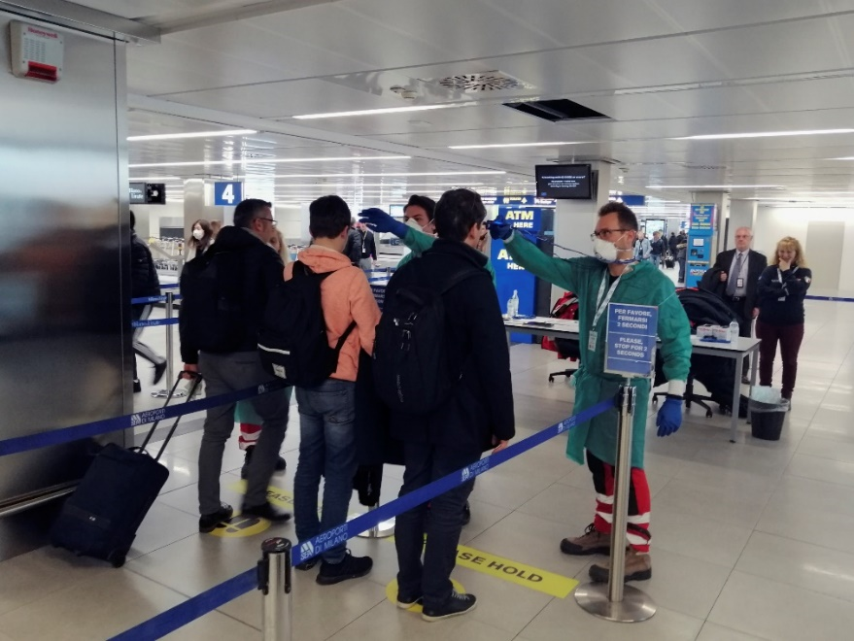

SO DO THE RIGHT THING
BE WISE & DO NOT COMPROMISE
Breaking the rules & even exhibiting it on social media!
Rejected to travel; impacts vessel, crew & company!
During COVID-19 pandemic control measures have been set by governments and authorities.
These must be strictly followed, so to ensure everyone’s safety and continuation of operations.

Slide 15
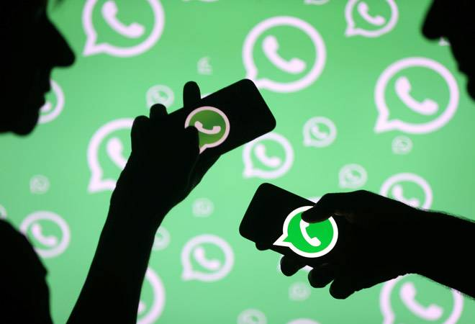
IS IT REALLY PRIVATE & SECURE?
INTERNET, MESSAGES, CALLS…
Don’t assume just because it’s a chat message or email that it is fully private and secure.
Once shared in ‘private’ chat, it can very easily be “re-shared” to the wider public.

Slide 16
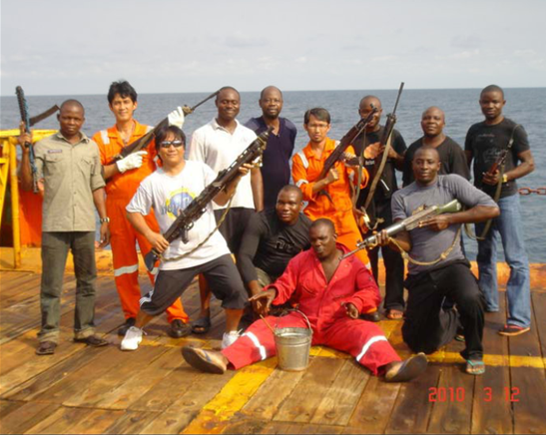
CONSIDER HOW IT MIGHT LOOK
AND IMPACT YOUR REPUTATION
This picture was later re-shared by various industry profiles and pages, with text suggesting crew were “Buddies with the Pirates”
Posts on social media are in the public domain and can easily be taken out of context.
This can have a negative affect on the Company’s professional reputation; Legal implications; and jeopardise your job.

Slide 17

BE A COMPANY AMBASSADOR
LOOK-OUT & INFORM
You’re a valuable asset for monitoring activity & protecting the Company’s reputation
If you come across criticism, it is best not to engage in debates, but rather notify company management to look into & take action

Slide 18
PROCEDURES
MAIN POINTS TO KNOW
OWNER’S POLICY
CONFIDENTIALITY
Never disclose sensitive company, vessel, crew or even your own information to press or on social media
SPOKESPEOPLE
Only authorised representatives may make public statements on behalf of the Company. This helps ensure information is accurate, consistent & relevant.
Where applicable, the ship owner’s policy & procedures shall always supersede

Slide 19

WITH ANY TOOL AND
INFORMATION YOU SHARE
ALWAYS USE YOUR BEST JUDGEMENT AND COMMON SENSE

Slide 20
THANK YOU!

Slide 21
DISCLAIMER
Content within this presentation is for preliminary informational purposes only and should not be regarded as offering a complete and final explanation/advice of all content and material referred.
This document contains data and information provided as seen, and at the time of production. Marlow Navigation reserves the right to amend/update such content based on new data and information in order to be most relevant at a given period, and as such, assumes no liability for accuracy of content within. Such is the nature of the maritime industry, that commercial figures and KPIs are dynamic and changing on a regular basis.
Copyright Notice
Material, content and work found on this Marlow Navigation presentation is copyright to Marlow Navigation Co Ltd.
Content & Data

